Slide 1
Distribution of Data

Slide 2
Why to learn Distributions?
Whenever you have data you should strive to find a shorthand way of expressing it.
Distribution of data is an important feature of data
Help in finding homogeneous data
Help in selecting features for machine learning
Feature engineering is very important
Best features selected will result in best model
Garbage In - Garbage out

Slide 3
Why to learn Distributions?
Helps in cleaning the data
Helps to select right approaches for data analytics
Analyzing a picture is easier than reading ONLY numbers
Useful in reproducing data / generating similar data

Slide 4
Random Variable
A variable with various values
A function that assigns values to possible outcomes of the experiment
A function that maps outcomes of experiments to real numbers
Types of random variables
Categorical (discrete)
It can have specific values. (ex. date, gender, name, …)
Continuous
It can have any value within a range (ex. age, cost, temperature, …)

Slide 5
Probability Distribution
It is a function that describes the likelihood of obtaining the possible values that a random variable can assume.
Distribution of data can be expressed by probability distribution
Probability is
p(x) = the likelihood that random variable takes a specific value of x.
The sum of all probabilities for all possible values must equal 1.
Probability for a particular value or range of values must be between 0 and 1.

Slide 6
Types of Distributions
Distributions for representing Data
Normal distribution
Binomial Distribution
Bernoulli Distribution
Negative Binomial
Poisson distribution
Geometric distribution
Exponential distribution
Others: logarithmic, t-test, etc

Slide 7
Normal Distribution
Also known as
Bell curve
Normal curve
Gaussian Distribution
Gaussian Curve
It is uniform distribution to model multiple events with the same probability, such as rolling a die.

Slide 8
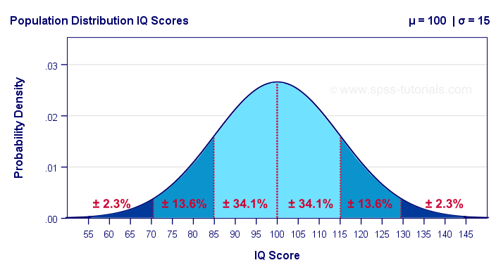
Normal Distribution
It is based on mean and standard deviation

Slide 9
Binomial Distribution
It models probability of success in sequence of ‘n’ independent experiments.
When experiments are dependent then it doesn’t follow binomial distribution
Each experiment can have only two outcomes (0/1)
For outcome
1 – probability is p
0 – probability is q or 1-p

Slide 10
Binomial Distribution
Specific rules should be met
Rule #1: There are only two mutually exclusive outcomes for a discrete random variable (i.e., success or failure).
Rule #2: There is a fixed number of repeated trials (i.e., successive tests with no outcome excluded).
Rule #3: Each trial is an independent event (meaning the result of one trial doesn't affect the results of subsequent trials).
Rule #4: The probability of success for each trial is fixed (i.e., the probability of obtaining a successful outcome is the same for all trials).

Slide 11
Binomial Distribution
Examples
Given 5 questions on a test, what is the probability of randomly guessing exactly 2 questions correctly? Possible outcomes: right / wrong Fixed number of repeated independent trials: 5
Given 3 different people swabs what is probability of exactly 2 people being positive in the medical test ?
Possible outcomes: positive / negative
Fixed number of repeated independent trials: 3

Slide 12
Bernoulli’s Distribution
It can be thought of as a model for the set of possible outcomes of any single experiment that has a binary outcome.
It is special case of Binomial distribution
Example: Rolling Dice: the probability of a roll of two die resulting in a double six.

Slide 13
Negative Binomial Distribution
It models the number of failures in a sequence of independent and identically distributed Bernoulli trials before a specified number of successes occurs.
Number of successes (r) is specified
Probability of failures till desired number of success is predicted here

Slide 14
Negative Binomial Distribution
The experiment consists of x repeated trials.
Each trial can result in just two possible outcomes. We call one of these outcomes a success and the other, a failure.
The probability of success, denoted by P, is the same on every trial.
The trials are independent; that is, the outcome on one trial does not affect the outcome on other trials.
The experiment continues until r successes are observed, where r is specified in advance.

Slide 15
Poisson distribution
It is the number of events occurring in a given time period, given the average number of times the event occurs over that time period.

Slide 16
Poisson distribution
The experiment results in outcomes that can be classified as successes or failures.
The average number of successes (μ) that occurs in a specified region is known.
The probability that a success will occur is proportional to the size of the region.
The probability that a success will occur in an extremely small region is virtually zero.

Slide 17
Poisson distribution
The average number of homes sold by the Acme Realty company is 2 homes per day. What is the probability that exactly 3 homes will be sold tomorrow?

Slide 18
Geometric Distribution
The probability distribution of the number X of Bernoulli trials needed to get one success, supported on the set { 1, 2, 3, ... }
The probability distribution of the number Y = X − 1 of failures before the first success, supported on the set { 0, 1, 2, 3, ... }
The geometric distribution represents the number of failures before you get a success in a series of Bernoulli trials.

Slide 19
Geometric Distribution
What is number of random trials required for getting correct answer for a mcq with two options?
Two options so probability of success = ½ = 0.5
What is number of random trials required for getting correct answer for a mcq with four options?
Two options so probability of success = 1/4 = 0.25

Slide 20
Exponential distribution
It is the probability distribution of the time between events in a process in which events occur continuously and independently at a constant average rate
Here we use rate / decay rate as a parameter
Example:
Time till battery of car expires
Time till change in your pocket is exhausted

